Slide 1
Problem statement
This open innovation challenge invites individuals, teams, and organizations to contribute their
innovative ideas, projects, and initiatives aimed at mitigating and adapting to climate change.
The challenge is intentionally open-ended, allowing participants to explore diverse approaches
and ideas to combat climate change.

Slide 2
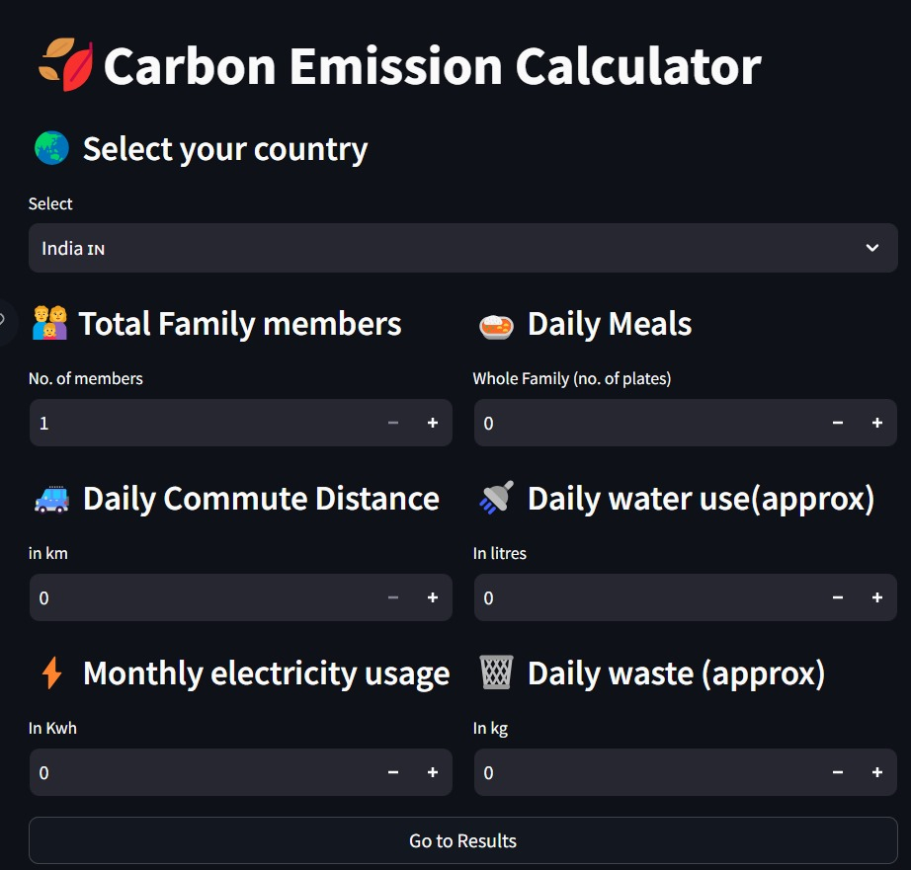
Introduction
Utilizing a carbon emission calculator as a means to mitigate climate change involves employing data and algorithms to approximate the carbon emissions of an entity. This estimation takes into account a range of factors, including energy usage, transportation patterns, and waste production. By providing pertinent details, individuals and organizations can acquire a deeper understanding of their impact on climate change and pinpoint strategies for diminishing their carbon footprint.

Slide 3
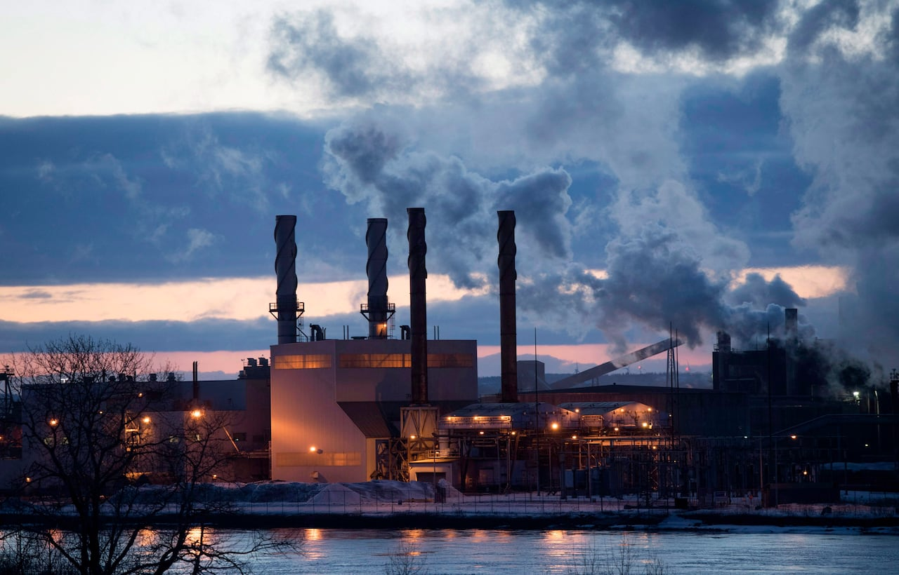
SCOPE OF SOLUTIONS
Reduction of greenhouse gas-emissions
Periodically reevaluate your carbon footprint using the calculator to assess whether you are meeting your reduction targets and make necessary adjustments.
Climate resilient and adaptation-strategies
Allocate resources for adaptation and resilience efforts based on the emissions data. Areas with high emissions and high vulnerability may require more substantial investments in climate-resilient infrastructure
Conservation and restoration of-ecosystems
Promote sustainable land use practices, such as agroforestry or sustainable agriculture, which not only reduce emissions but also protect and enhance ecosystems.

Slide 4
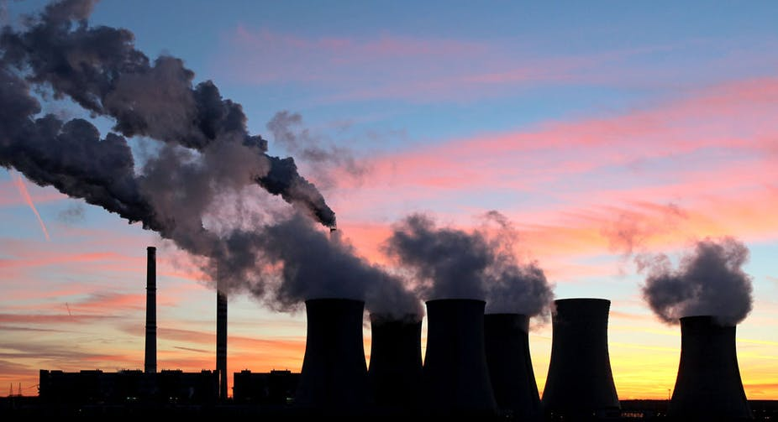
Climate awareness and education- programme
Provide participants with resources, including fact sheets, videos, and websites, that support their understanding of climate change and carbon reduction strategies.
Circular economy and waste reduction- initiatives.
Develop e-waste recycling and disposal programs to reduce the carbon footprint associated with electronic waste.
Sustainable energy solutions-
Invest in carbon offset projects, such as reforestation or methane capture from landfills, to compensate for emissions that cannot be eliminated through efficiency measures or renewable energy adoption. Calculate the emissions reductions achieved through offset projects.

Slide 5
UNIQUENESS OF THE CONCEPT IN CONTRAST TO ESTABLISHED ALTERNATIVES
Visual Data Comparison: Using a bar chart to compare data with global and national averages.
Tailored Emission Reduction Solutions: Customized solutions categorized by emissions reduction measures.
Sharing on Social Media: Disseminating results across various social media platforms.
Future AI Recommendations: Integrating artificial intelligence to enhance the program's capabilities for future requirements.

Slide 6
